Slide 1


Real Estate Management Process Improvement
Agile Software Development - INFO7245 (38772)
Final Project - April 14, 2020
Himani Solanki | Aakash Deogaonkar | Shardul Negi | Hardik Soni

Slide 2



Introduction
Smart IT Technologies is an IT consulting firm and has been approached by a Real Estate Management company from Las Vegas to improve their monthly operational processes and tools.
The Real Estate Management company specializes in luxury short term rentals and most of the bookings are made through Airbnb. There are ~60 units in the portfolio so monthly reporting and weekly processes are quite manual.
Monthly Reporting Process
Consolidation & Reporting Process
Market Palm Place Villa

Slide 3



Challenges in Current Process
Monthly Financial Reporting Process
Prone to human errors
Time consuming
Knowledge transfer and time to learn in case of employee turnover
Data Consolidation & Analysis
Lack of automation to collect the data
Manual & prone to errors
No structured data to access and analyze statistics
No Marketing Strategy and Sponsorship Framework
No digitization
Expensive print media
Can't reach wide customer base

Slide 4



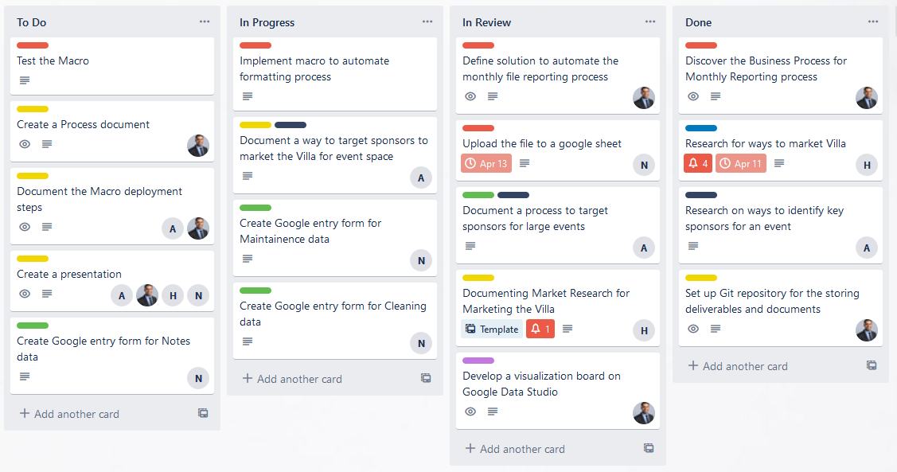
Approach & Tools
The team at Smart IT Technologies followed a Scrum-based approach to discover and ideate over the problem and identify solutions.
The deliverables were spanned across two 1-week sprints:
Sprint 1
Identify solutions across the process
Macro to automate formatting process
Google Forms for Maintenance, Cleaning, and Notes
Sprint 2
Visualizations boards
Documentation (Recommendation & Deployment)
Presentation
Git URL: https://github.com/INFO7245-AGILE-TEAM7/finalproject_realestate_consulting.git

Slide 5



Solution
Semi-Automated Monthly Reporting Process
Excel Macros
Python Scripts
Automated consolidation & Reporting Process
Google Forms
Google Data Studio
Efficient Marketing
Marketing Strategies
Sponsorship Process

Slide 6
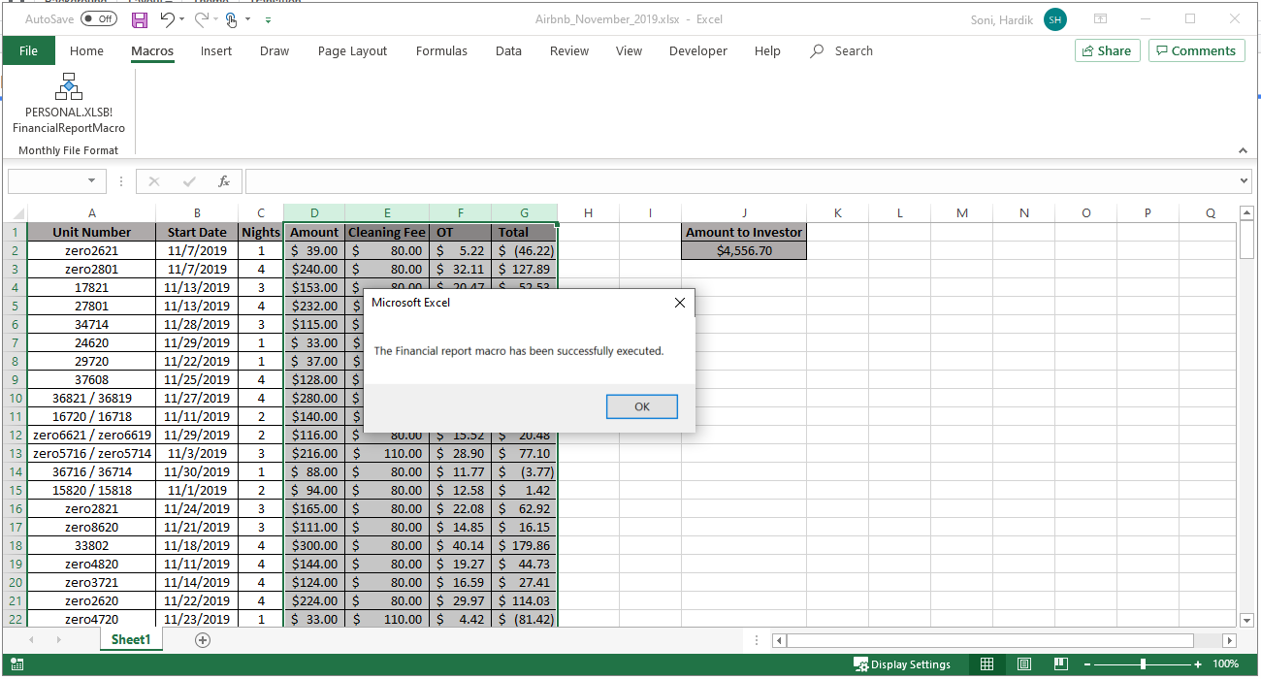
Demo - Formatting Macro

Slide 7
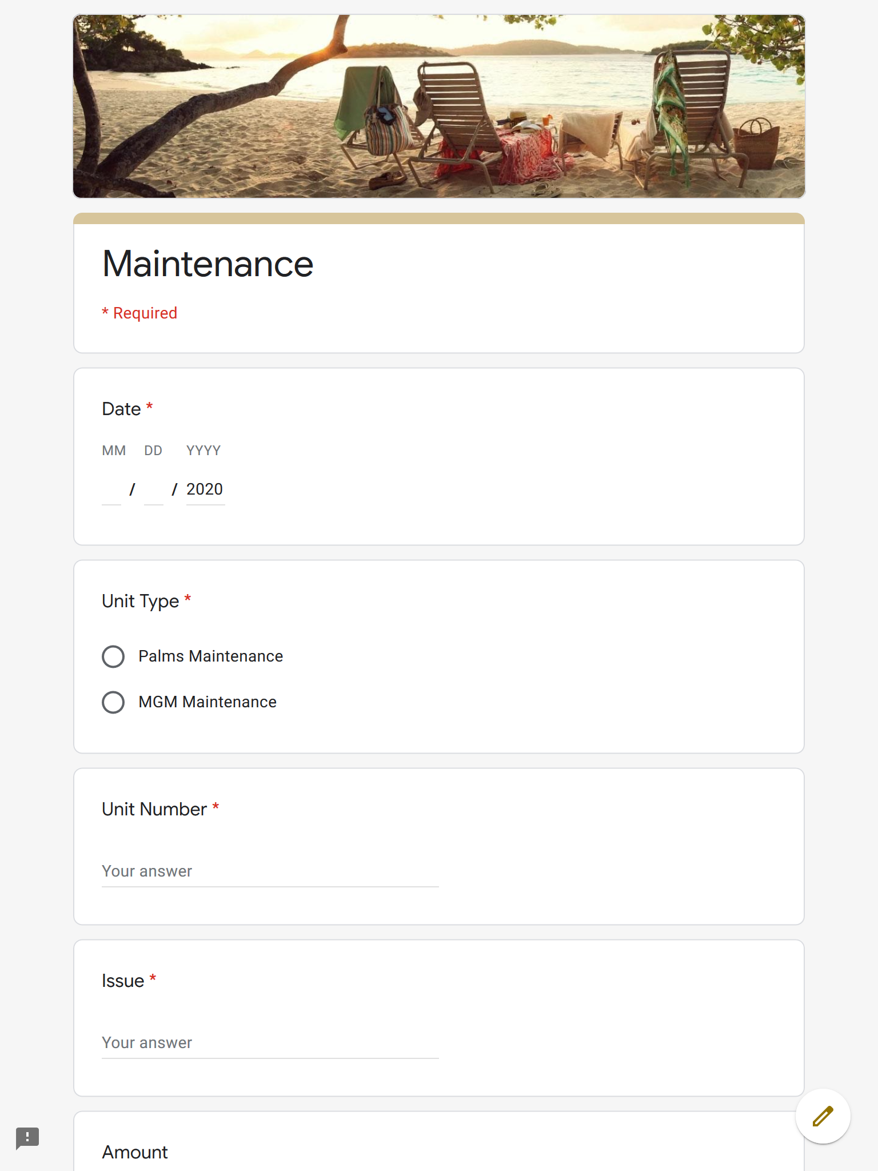
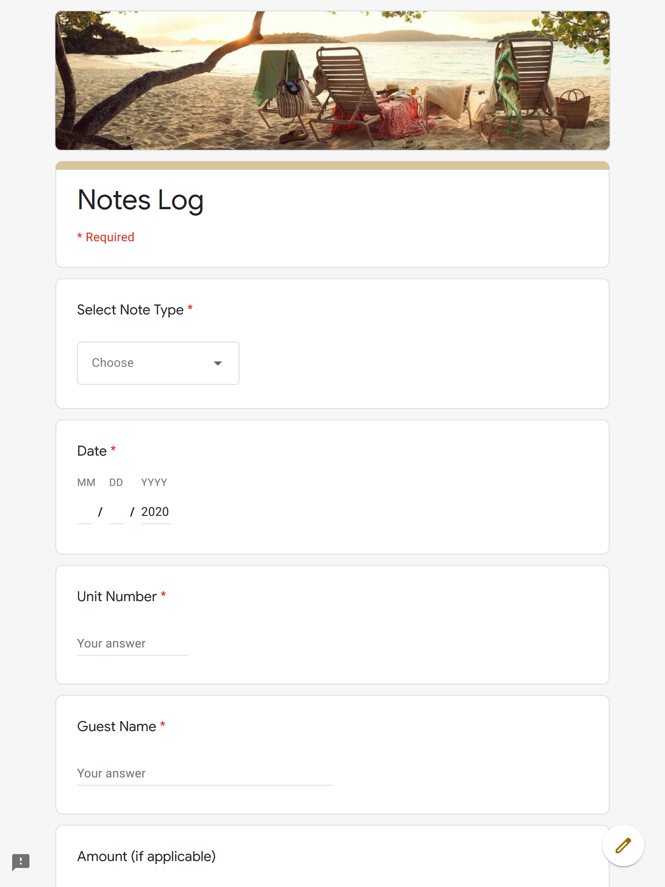
Demo - Google Forms

Slide 8
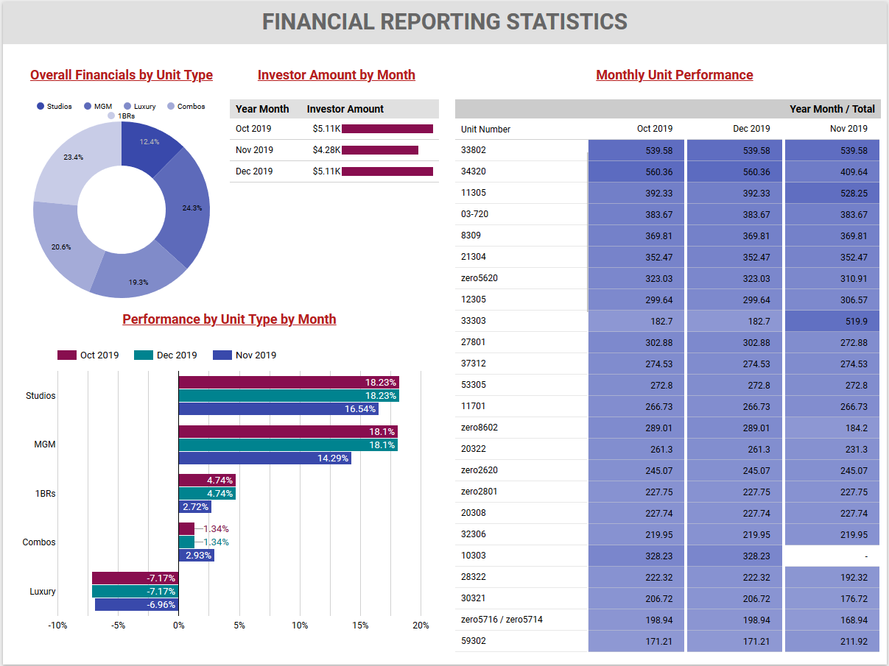
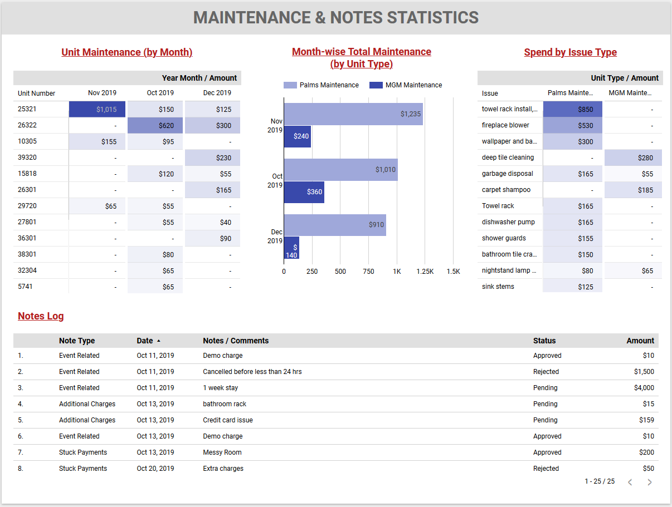
Demo - Visualization via Google Data Studio

Slide 9










Marketing Strategies
No matter how appealing your villa is, it is how it is packaged and marketed that really catches the eye and captures the imagination. From the design details to the spectacular location, your villa may be catwalk-ready to parade in front of the luxury villa rental market, but you still need to strut your stuff.
Website Management
Strategy and Analysis
Blogging and Copywriting
Search Engine Optimization
Social Media Management
Relationship Building
Paid Media Management
Creative Skills
Email Marketing
Event Planning

Slide 10
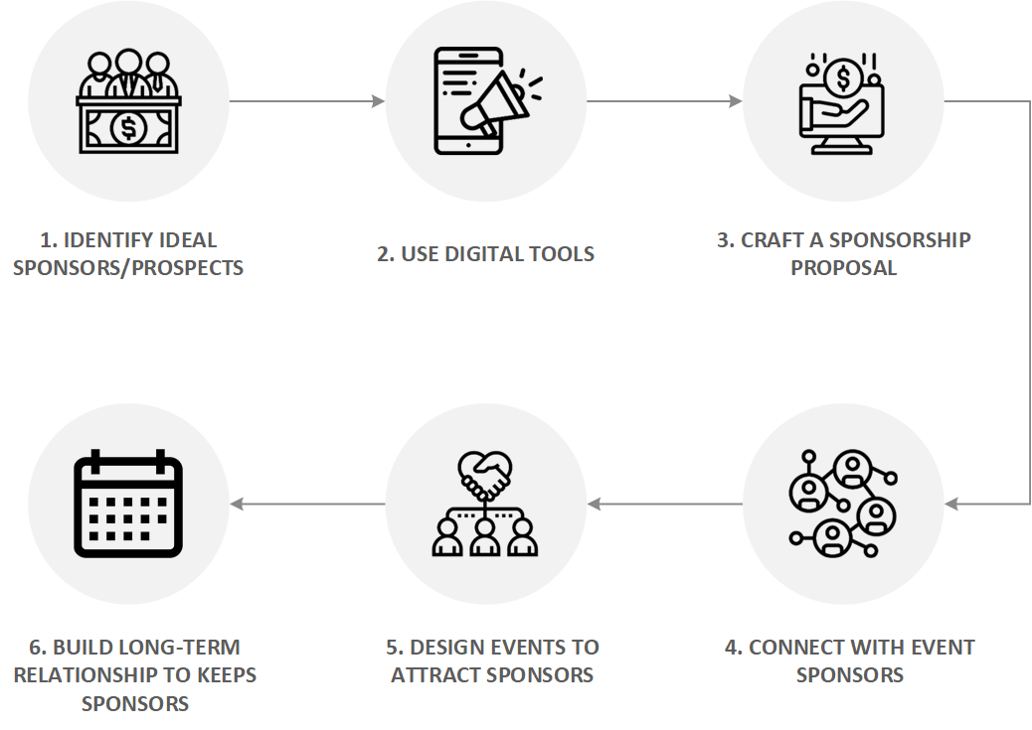
Sponsorship Process

Slide 11




Roles
Hardik Soni
Product Owner
Defined vision & strategy
Managed product backlog
Led development and improvements
Shardul Negi
Scrum Master
Facilitated daily scrum
Estimated & Planned Sprints
Designed and developed Google forms
Aakash Deogaonkar
Developer
Developed Macro
Developed Python scripts
Visualized data through Google Data Studio
Himani Solanki
Business Analyst
Researched Marketing Techniques
Researched process to finding sponsorer
Documented Marketing Techniques and Sponsor Framework

Slide 12



Results
Reduced 50% of formatting effort
Visibility and accessibility of data
Solid strategic framework to market Palm Place villa

Slide 13


Lessons Learned
What went well?
Executing project with Agile helped us streamline as a team
Prototyping allowed early learning
Well defined deliverables for the final outcome
Open and honest communication
What went bad?
We as team were not aware of our velocity and this led to overplanning and committing more story points

